Slide 1
Spectral Clustering with Ensemble of Autoencoders
Presented by: Prithul Sarker

Slide 2
Problem
Clustering is the task of grouping a set of objects or data in such a way that objects in the same group are more similar to each other than to those in other groups. Clustering is one of the main tasks in unsupervised machine leaning.
Spectral Clustering is one of the most popular clustering algorithms. It makes use of the eigenvalues of the Laplacian matrix to perform dimensionality reduction before clustering.
The problem addressed here is spectral clustering shows difficulty in approximating proper Laplacian matrix when the input has high dimension such as images.
Notes:
Clustering: assign unlabeled data to groups

Slide 3
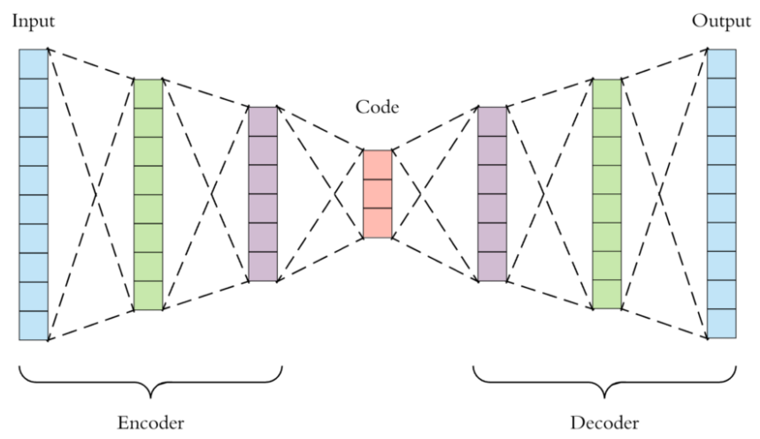
Project Planning
Autoencoder components
Encoder: The input data is encoded to lower dimension into a latent space representation.
Code: This bottleneck layer tries to hold as much information as possible without losing important features.
Decoder: It decompresses the compressed data and tries to mimic the original input data.
Notes:
Encoder: In this part, the input data (here image) is encoded to lower dimension using multiple convolutional networks. By doing this, the input image is compressed into a latent space representation. The compressed image is the distorted version of the original image.
Code: As shown in Figure 1, the middle layer between the encoder and decoder is the code part. In this layer, I used dense function to compress the previous layer input to multiple units. This layer is the bottleneck layer. It tries to hold as much information as possible without losing any important features of the original image.
Decoder: This feedforward network is similar to the encoder, but the difference is that it tries to decompress the compressed data and tries to mimic the original input without losing any important features. For this process, I used Conv2DTranspose library function to have the same dimension of the original image.

Slide 4
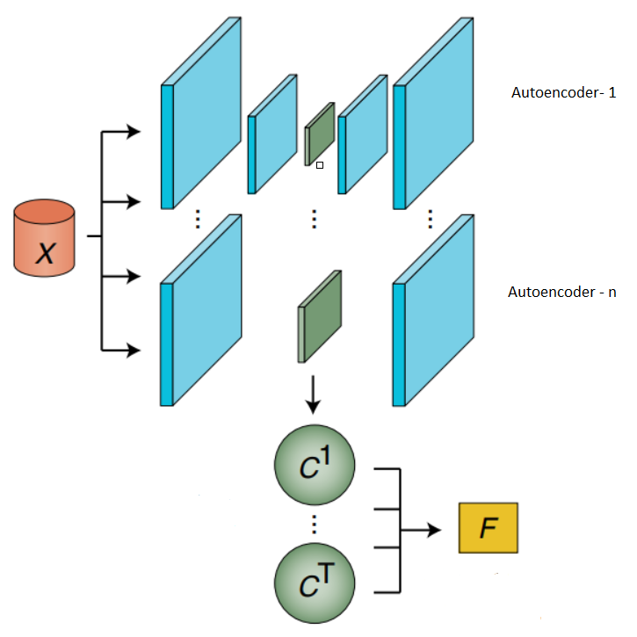
Project Planning
Ensemble learning refers to a class of strategies where instead of building a single model, multiple base models are combined to perform tasks.
Ensemble of Autoencoders is used to perform spectral clustering in this project.
The objective of this project is to validate if ensemble of autoencoders is more resilient for clustering algorithm.

Slide 5
Literature Review
“Deep Unsupervised Clustering Using Mixture of Autoencoders” (2017) paper by Zhang, D. et al.: A separate autoencoder to model each data cluster, and thereby the entire dataset as a collection of autoencoders.
“A Novel Deep Learning-Based Multi-Model Ensemble Method for The Prediction of Neuromuscular Disorders” (2018) by Khamparia A. et al.: Adopted convolutional neural networks (CNN) as the ensemble method to assemble multiple classifiers.

Slide 6
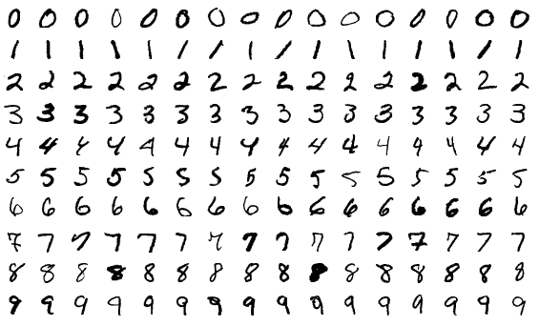
Dataset- MNIST (Modified National Institute of Standards and Technology database)
Large database of handwritten digits (black and white)
60,000 training images (6,000 images per digit)
10,000 test images (1,000 images per digit)
Input size: 28x28x1

Slide 7
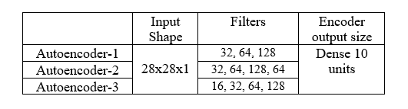
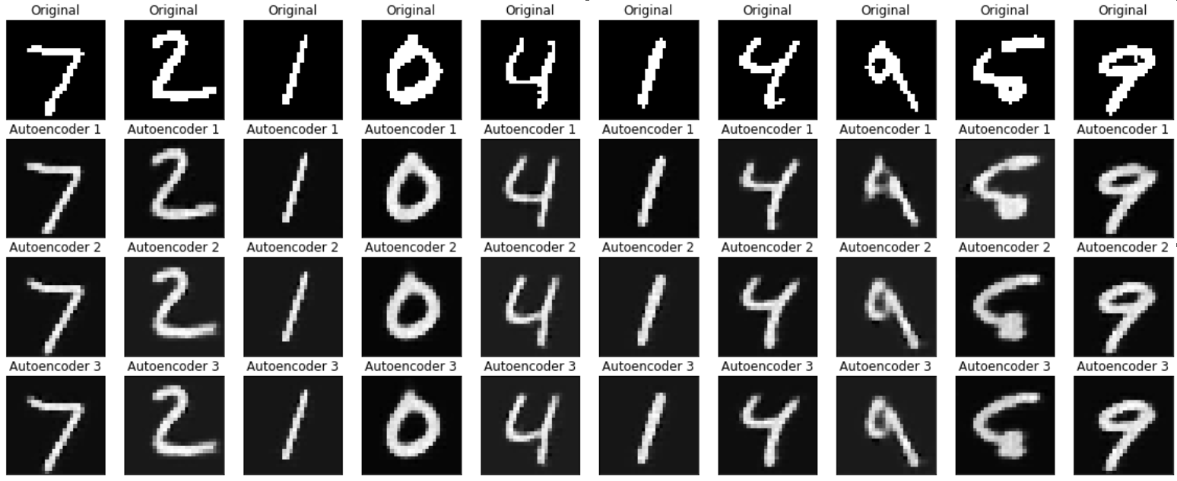
Project Description

Slide 8

Project Description
A point-based metric system is used to choose the best autoencoder model.
The autoencoder with minimum mean squared error per image gets a point.
The autoencoder with maximum point for both training and test data is chosen as the final model.

Slide 9
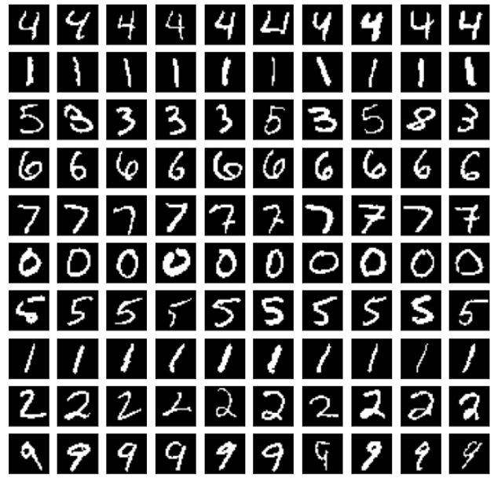
Results
The encoded images are fed into the input of the spectral clustering.
The number of clusters is 10.
The whole program took over 1 hour in total to run.

Slide 10
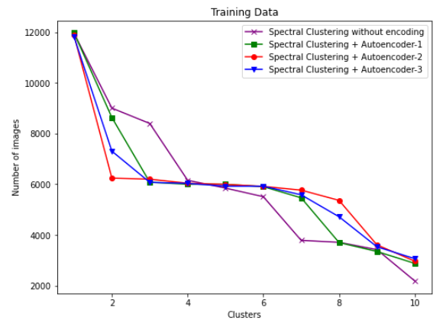
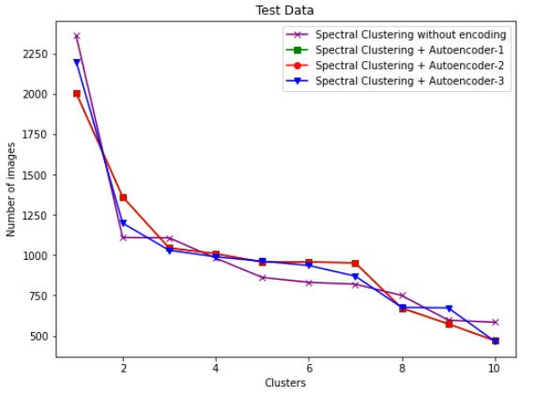
Evaluation

Slide 11
Conclusion
Scope for improvement:
Complex networks
Better metric for point system
Variational autoencoder

Slide 12
Thank you

